Slide 1
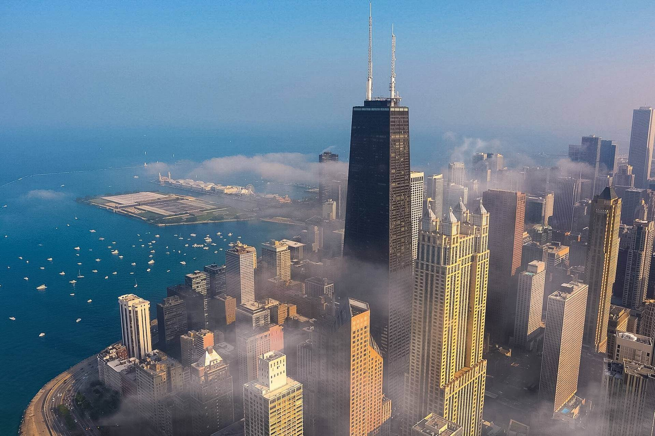
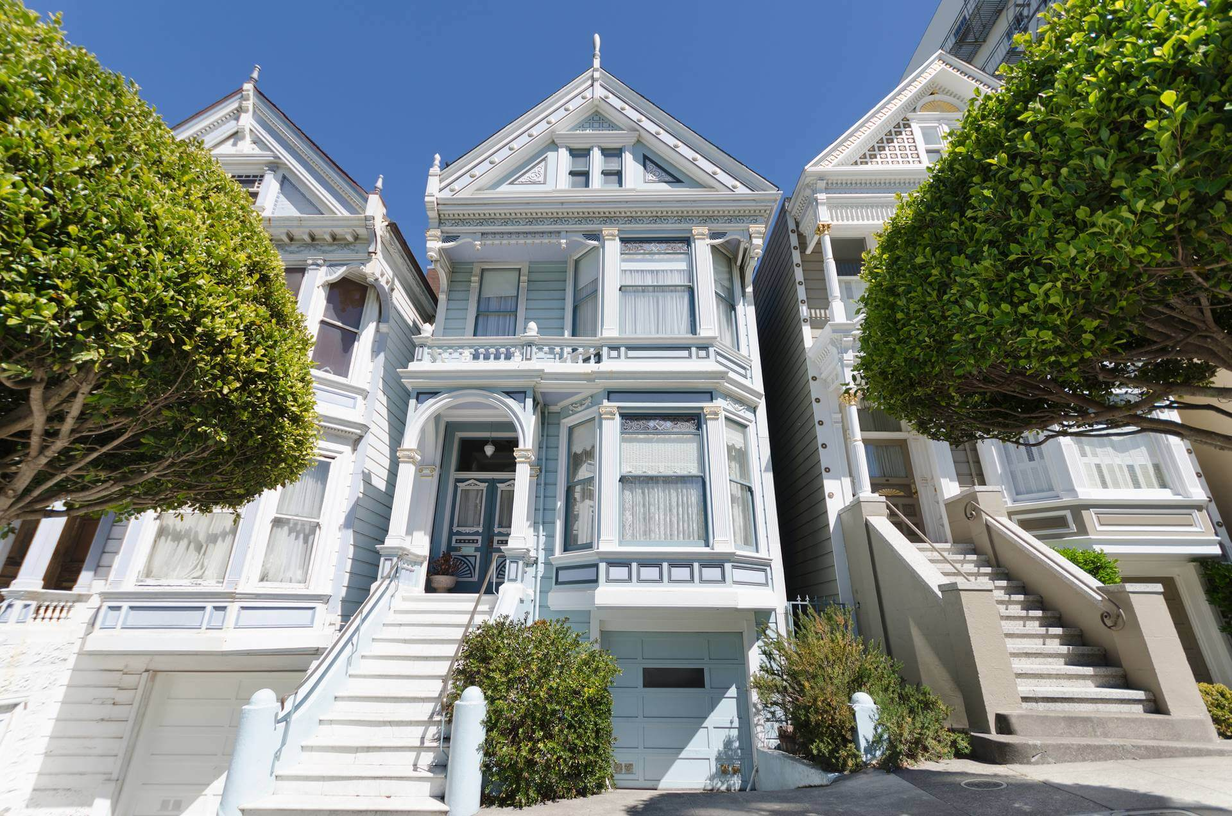




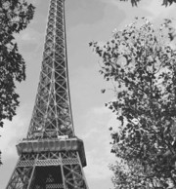
History timeline 1
THIS DAY IN HISTORY
1925
1933
1952
1964
1965
1970
1980
JANUARY
15TH
FEBRUARY
5TH
MARCH
6TH
APRIL
7TH
MAY
7TH
JUNE
17TH
JULY
18TH
Hans Luther forms German government
Crew of Dutch "7 Provinces" mutiny after pay cuts
Cuban coup d'état took place in Cuba
Hugh Martin and Timothy Gray's musical "High Spirits” opens at Alvin Theater, NYC
Bill Shoemaker wins Kentucky Derby with Lucky Debonair
British rock band Led Zeppelin begin their last European tour
Billy Joel's album tops US charts, featuring "It's Still Rock 'n' Roll to Me"

Slide 2
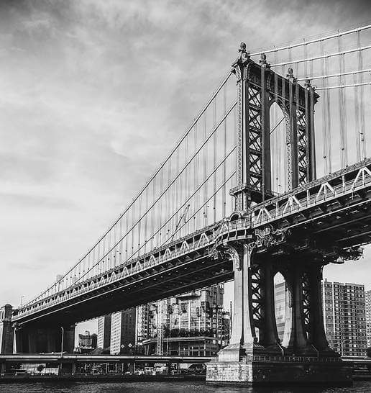

History timeline 2
THIS DAY IN HISTORY
FEBRUARY
5TH
APRIL
7TH
JUNE
17TH
Crew of Dutch "7 Provinces" mutiny after pay cuts
Hugh Martin and Timothy Gray's musical "High Spirits” opens at Alvin Theater, NYC
British rock band Led Zeppelin begin their last European tour
1925
1933
1952
1964
1965
1970
1980
JANUARY
15TH
MARCH
6TH
MAY
7TH
JULY
18TH
Hans Luther forms German government
Cuban coup d'état took place in Cuba
Bill Shoemaker wins Kentucky Derby with Lucky Debonair
Billy Joel's album tops US charts, featuring "It's Still Rock 'n' Roll to Me"

Slide 3

History timeline 3
THIS DAY IN HISTORY
JANUARY
15TH
FEBRUARY
5TH
MARCH
10TH
APRIL
7TH
MAY
1ST
JUNE
17TH
JULY
18TH
Hans Luther forms German government
Crew of Dutch "7 Provinces" mutiny after pay cuts
Cuban coup d'état took place in Cuba
Hugh Martin and Timothy Gray's musical "High Spirits” opens at Alvin Theater, NYC
Bill Shoemaker wins Kentucky Derby with Lucky Debonair
British rock band Led Zeppelin begin their last European tour
Billy Joel's album tops US charts, featuring "It's Still Rock 'n' Roll to Me"
1925
1952
1965
1980
1933
1964
1970

Slide 4







History timeline 4
JUNE
4TH
JULY
15TH
AUGUST
29TH
SEPTEMBER
15TH
OCTOBER
11TH
NOVEMBER
19TH
DECEMBER
16TH
Hans Luther forms German government
Crew of Dutch "7 Provinces" mutiny after pay cuts
Cuban coup d'état took place in Cuba
Hugh Martin and Timothy Gray's musical "High Spirits” opens at Alvin Theater, NYC
Bill Shoemaker wins Kentucky Derby with Lucky Debonair
British rock band Led Zeppelin begin their last European tour
Billy Joel's album tops US charts, featuring "It's Still Rock 'n' Roll to Me"

Slide 5
History timeline 5
THIS DAY IN HISTORY
JANUARY 15TH
Hans Luther forms German government
JUNE 17TH
British rock band Led Zeppelin begin their last European tour
JULY 18TH
Billy Joel's album tops US charts, featuring "It's Still Rock 'n' Roll to Me"
FEBRUARY 5TH
MARCH 6TH
APRIL 7TH
MAY 7TH
Cuban coup d'état took place in Cuba
Crew of Dutch "7 Provinces" mutiny after pay cuts
Hugh Martin and Timothy Gray's musical "High Spirits” opens at Alvin Theater, NYC
Bill Shoemaker wins Kentucky Derby with Lucky Debonair
1933
1964
1970
1925
1952
1965
1980

Slide 6
History timeline 6
THIS DAY IN HISTORY
JUNE 4TH
Hans Luther forms German government
NOVEMBER 19TH
British rock band Led Zeppelin begin their last European tour
DECEMBER 16TH
Billy Joel's album tops US charts, featuring "It's Still Rock 'n' Roll to Me"
JULY 15TH
AUGUST 29TH
SEPTEMBER 15TH
OCTOBER 11TH
Cuban coup d'état took place in Cuba
Crew of Dutch "7 Provinces" mutiny after pay cuts
Hugh Martin and Timothy Gray's musical "High Spirits” opens at Alvin Theater, NYC
Bill Shoemaker wins Kentucky Derby with Lucky Debonair
1933
1964
1970
1925
1952
1965
1980

Slide 7

History timeline 7
THIS DAY IN HISTORY
JAN
15TH
MAR
6TH
MAY
7TH
JUL
18TH
1925
1952
1965
1980
FEB
5TH
APR
7TH
JUN
17TH
Hans Luther forms German government
1933
Cuban coup d'état took place in Cuba
1964
Bill Shoemaker wins Kentucky Derby with Lucky Debonair
1970
Billy Joel's album tops US charts, featuring "It's Still Rock 'n' Roll to Me"
Crew of Dutch "7 Provinces" mutiny after pay cuts
Hugh Martin and Timothy Gray's musical "High Spirits” opens at Alvin Theater, NYC
British rock band Led Zeppelin begin their last European tour

Slide 8
History timeline 8
JUN
4TH
AUG
29TH
OCT
11TH
DEC
16TH
JUL
15TH
SEP
15TH
NOV
19TH
Hans Luther forms German government
Cuban coup d'état took place in Cuba
Bill Shoemaker wins Kentucky Derby with Lucky Debonair
Billy Joel's album tops US charts, featuring "It's Still Rock 'n' Roll to Me"
Crew of Dutch "7 Provinces" mutiny after pay cuts
Hugh Martin and Timothy Gray's musical "High Spirits” opens at Alvin Theater, NYC
British rock band Led Zeppelin begin their last European tour

Slide 9


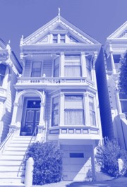




HISTORY TIMELINE 9
1970
1964
Billy Joel's album tops US charts, featuring "It's Still Rock 'n' Roll to Me"
Hans Luther forms German government
1933
Bill Shoemaker wins Kentucky Derby with Lucky Debonair
Cuban coup d'état took place in Cuba
British rock band Led Zeppelin begin their last European tour
Hugh Martin and Timothy Gray's musical "High Spirits” opens at Alvin Theater, NYC
1965
Crew of Dutch "7 Provinces" mutiny after pay cuts
1980
1952
1925
THIS DAY IN HISTORY

Slide 10







HISTORY TIMELINE 10
DEC
16TH
OCT
11TH
Billy Joel's album tops US charts, featuring "It's Still Rock 'n' Roll to Me"
JUN
4TH
Bill Shoemaker wins Kentucky Derby with Lucky Debonair
Hans Luther forms German government
AUG
29TH
Cuban coup d'état took place in Cuba
NOV
19TH
SEP
15TH
British rock band Led Zeppelin begin their last European tour
Hugh Martin and Timothy Gray's musical "High Spirits” opens at Alvin Theater, NYC
JUL
15TH
Crew of Dutch "7 Provinces" mutiny after pay cuts
THIS DAY IN HISTORY

